Slide 1
Syntax Directed Translation
Dr. Shamim H Ripon
CSE

Slide 2
Source
Program
Lexical analyzer
Program Input
Tokens
Syntax Analyzer
Parse tree/
Abstract Syntax Tree
Semantics Analyzer
Result
Attributed AST
Intermediate Code
Generation
Code Optimizer
Code Generator
Target
Program

Slide 3
Syntax directed translation
A method of compiler implementation where the translation is completely driven by parse tree.
Augment the grammar with attributes (information) to control semantic analysis and translation.
Attributes: relevant information associated with grammar constructs.

Slide 4
Syntax directed definition
A CFG together with attributes and rules
Associate a set of attributes with each grammar symbol
Attributes can be anything: string, tree, number, memory location etc
Associate a set of semantic rules with each production
How to compute attribute values of symbols
Attributes are partitioned in two subsets
Synthesized
Inherited
Attribute grammars are a method to annotate parse tree

Slide 5
Synthesized attribute
An attribute is synthesized if
The attribute value of parent is determined from the values of children parse tree.
Attributes are computed purely bottom-up

Slide 6
Example
Expr
Expr
Bin-op
Expr
Var
+
Expr
Bin-Op
Expr
*
Var
Var
a.lexval=4
a
b.lexval=3
b
c.lexval=5
c

Slide 7
Example
Expr
Expr
Bin-op
Expr
Expr.val=4
Var
+
Expr
Bin-Op
Expr
Var.val=4
Expr.val=3
Expr.val=5
*
Var.val=3
Var
Var
a.lexval=4
a
Var.val=5
b.lexval=3
b
c.lexval=5
c

Slide 8
Example
Expr.val=19
Expr
Expr
Bin-op
Expr
Expr.val=15
Expr.val=4
Var
+
Expr
Bin-Op
Expr
Var.val=4
Expr.val=3
Expr.val=5
*
Var.val=3
Var
Var
a.lexval=4
a
Var.val=5
b.lexval=3
b
c.lexval=5
c

Slide 9
Flow of Attribute in EXPR:
LHS attribute is computed using RHS attributes
Purely bottom-up: computer attribute values of all children in the parse tree
Use them to compute the value of parent

Slide 10
Inherited Attribute
An attribute is inherited if
The attribute value of a node is determined from attribute values of its parent and siblings
Convenient for expressing the dependence of a programming language construct on the context in which it appears.
e.g., can use to keep track of whether an identifier appears on the left or the right
Consider the grammar:
Var-decl → Type Id-comma-list;
Type → int | bool
Id-comma-list → ID
Id-comma-list → ID, Id-comma-list

Slide 11
Example: int x, y, z ;
Var-decl
Id-Comma-List
;
Type
int
ID
,
Id-Comma-List
x
ID
,
Id-Comma-List
y
ID
z

Slide 12
Example: int x, y, z ;
Var-decl
Id-Comma-List
;
Type
Type.val=int
I-C-L.in=int
int
ID
,
Id-Comma-List
I-C-L.in=int
ID.val=int
x
ID
,
Id-Comma-List
I-C-L.in=int
ID.val=int
y
ID
ID.val=int
z

Slide 13
Flow of Attributes
ID takes its attribute from its parent node
Id-Comma-List takes its attribute from its left sibling type
Computing attributes purely bottom-up is not sufficient in this case

Slide 14
Dependency Graphs
Dependency Graphs
Depicts the flow of information among the attributes instances.
If attribute b at a node in parse tree depends on an attribute c, then the semantic rule for b must be evaluated after that in c
For each grammar symbol X, the dependency graph has a node for each attribute associated with X
The dependency graph has an edge
from X.c to A.b when the value of synthesized attribute A.b is defined in terms of the value of X.c
X.a to B.c when the inherited attribute B.c is defined in terms of X.a

Slide 15
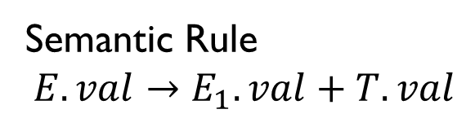
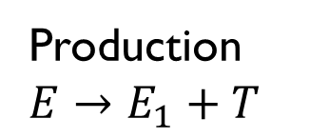

Example
Production
$$E→E_{1}+T$$
Semantic Rule
$$E.val→E_{1}.val+T.val$$
E
val
$$E_{1}$$
val
+
T
val

Slide 16
Evaluation Order
The dependency graph depicts the possible order in which the attributes at the node can be evaluated:
If there is an edge from M to N then attribute at M must be evaluated before that of N
The ordering converts the directed graphs into a linear order, called topological sort of the graph.

Slide 17
Syntax Tree
Syntax Tree
A condensed form of parse tree useful for representing language constructs
Created using SDD
Operators and keywords do not appear as leaves, but associate with interior node that would be parent of those leaves.
Chains of single productions may be collapsed.

Slide 18
Constructing Syntax Trees
Construction of tree for an expression is similar to postfix conversion of the expression
Nodes can be represented as a record with many fields:
One field for the operator
Remaining fields contain pointer to the nodes for the operands
Steps:
If the node is a leaf, a field holds the lexical value
Constructor function Leaf(op, val) creates the record and returns the pointer of the new leaf
If the node is an interior node, there are fields for each children
Constructor function: Node(op, c1,c2….ck) creates the record containing the pointer to its children

Slide 19
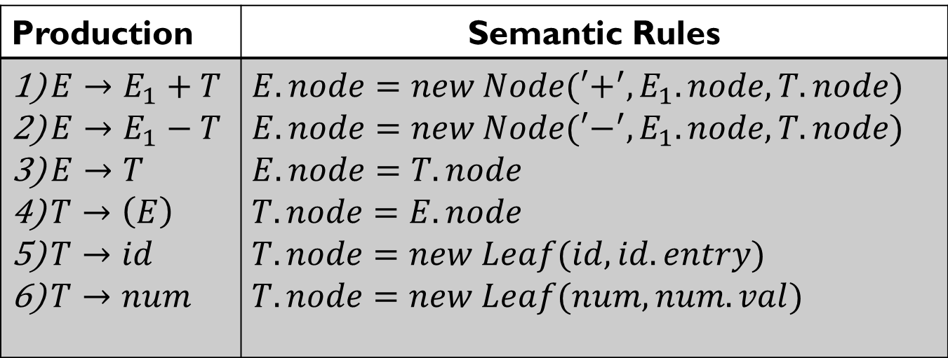
Example
Production | Semantic Rules
$E→E_{1}+T$ $E→E_{1}−T$ $E→T$ $T→\left(E\right)$ $T→id$ $T→num$ | $$E.node=new Node(′+^{′},E_{1}.node,T.node)$$ $$E.node=new Node(′−^{′},E_{1}.node,T.node)$$ $$E.node=T.node$$ $$T.node=E.node$$ $$T.node=new Leaf(id,id.entry)$$ $$T.node=new Leaf(num,num.val)$$

Slide 20
Example
Steps for: a – 4 + c
p1 = new Leaf(id, entry-a)
p2 = new Leaf(num,4)
p3 = new Node(‘-’, p1,p2)
p4 = new Leaf(id, entry-c)
p5 = new Node(‘+’,p3,p4)
Check Book

